Slide 1
Value Chain Analysis
Guest lecture by Carl Cervone
February 18, 2021

Slide 2



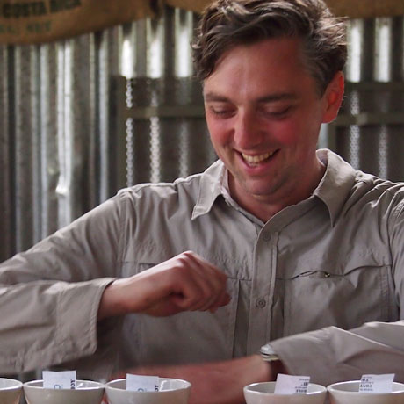
Our panellists
Senthil
Indonesia
Operations (Asia)
Diana
New York
Product/Impact
Celine
Côte d’Ivoire
Operations (Africa)
Nick
New York
Partnerships

Slide 3
Value chain analysis in the real world

Slide 4
How has COVID affected the coffee/cocoa value chains?

Slide 5
How has COVID affected labor dynamics in producing countries?

Slide 6
Value chain analysis and the sustainability agenda of the next decade

Slide 7
Some pointers when doing VCA in the real world
Context, context, context
Identify the right mix of stakeholders to interview
Get diverse opinions
Carry a USB drive (people never email data after you leave)
Official statistics aren’t always accurate
Corroborate numbers with different sources
Go bottom-up and top-down
Talk through hypotheses with experts
One-size-fits-all solutions are rare; segmentation is usually needed
Keep slides simple

